Slide 1
Programming in python: selection
Lesson 3: If else

Slide 2
Objectives
In this lesson, you will learn:
how to write a program in Python that uses an if-else statement
how to write a program in Python that uses multiple if statements and an else statement to consider a number of conditions when making a decision.

Slide 3
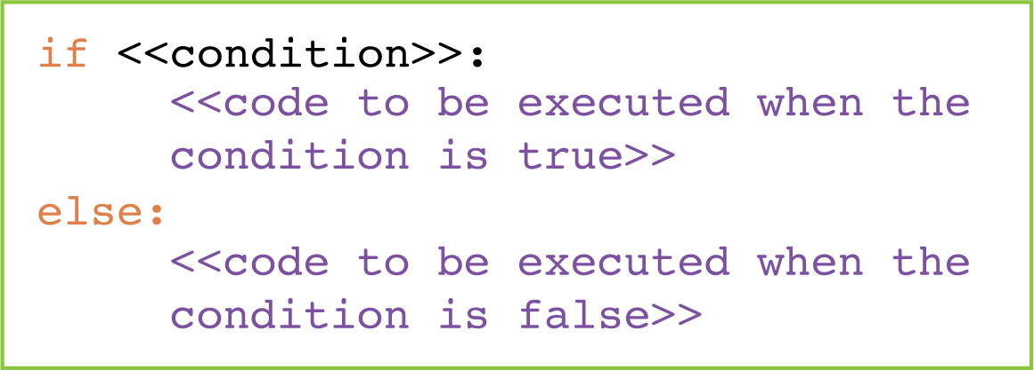
if else statements
if statements are used to decide what to do next if a condition is true. If we also want to tell the program what to do if the condition is false, we use an else statement:

Slide 4
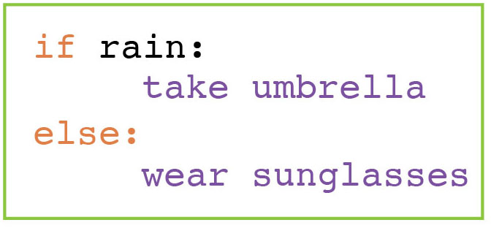
Decisions in algorithms
For example:

Slide 5

Activity 3.1: Programming in Python: selection, Section 3

Slide 6
Questions
Complete the program by filling in the gaps. It asks the user to print a number between 5 and 10 and outputs 'Too small' if the number is below 5, 'Too big' if the number is above 10 and the number if it is between 5 and 10.
num = int(input('Enter a number between 5 and 10: '))
if num __ 5:
print('Too small')
if num > ____:
print('______________')
__________
print('You chose’, _____)
<
10
Too big
else:
num

Slide 7
Quiz 3

